Slide 1

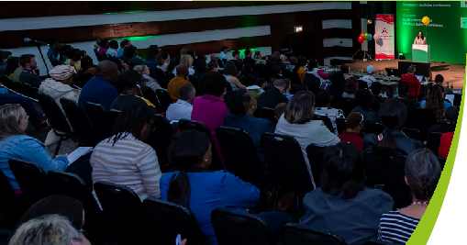













I’m speaking
at Africa Health 2024
22-24 October 2024
Cape Town International Convention Centre, South Africa
Co-located with:
Join me

